Slide 1



NREGA Data Analysis and Insights
Presented by- AHMAD FAHAD

Slide 2

Introduction
Objective: To analyze the NREGA dataset and extract meaningful insights regarding employment generation, budget utilization, and program efficiency.
Scope: This presentation covers data from various states and districts in India, focusing on key performance indicators and regional disparities.

Slide 3

Dataset Overview
Source: Official government records
Job Cards and Workers: Number of job cards
issued and active workers.
Expenditure: Budget allocation and utilization.
Work Statistics: Number of works taken up,
ongoing, and completed.

Slide 4

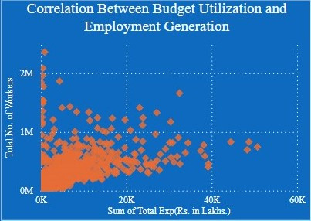
Employment Opportunities Analysis
X-axis: State Name/District Name
Y-axis: Total No. of JobCards issued, Total No. of Workers, Total No. of Active Job Cards, Total No. of Active Workers.
Insight: This graph highlights the distribution of employment opportunities provided by NREGA across different regions.

Slide 5

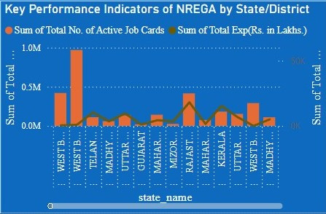
Regional Disparities in Implementation
X-axis: State Name/District Name
Y-axis: Total No. of JobCards issued,
Total No. of Active Workers
Insight: Identify regions with higher or
lower implementation effectiveness,
helping to pinpoint areas needing improvement.

Slide 6
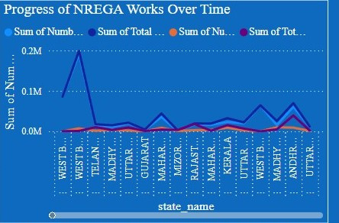
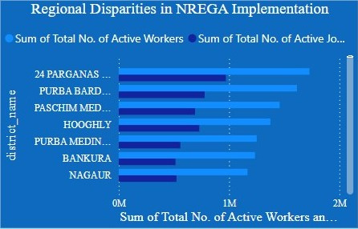
Budget Utilization and Employment Generation
X-axis: Total Expenditure (Rs. in Lakhs)
Y-axis: Total No. of Workers
Insight: Analyze how budget allocation correlates with the number of jobs generated, indicating the efficiency of fund usage.

Slide 7

Progress of NREGA Works Over Time
X-axis: State Name/District Name
Y-axis: Total No. of Works Takenup (New+Spill Over), Number of Ongoing Works, Number of Completed Works
Insight: Track the progress and
completion rates of NREGA works over the specified time period.

Slide 8

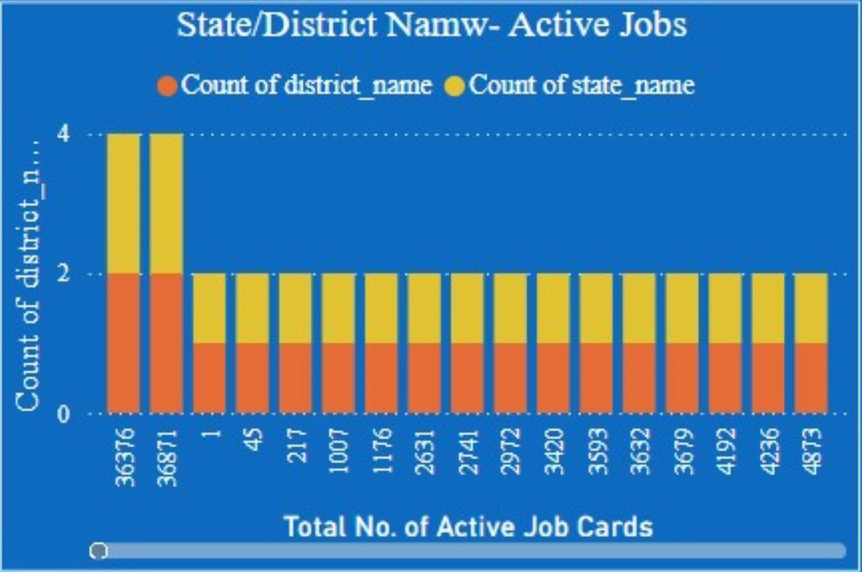
Key Performance Indicators by Region
X-axis: State Name/District Name
Y-axis (left): Total No. of JobCards issued,
Total No. of Works Takenup
Y-axis (right): Total Expenditure
Insight: Compare key performance indicators across different regions to identify trends and areas for improvement.

Slide 9
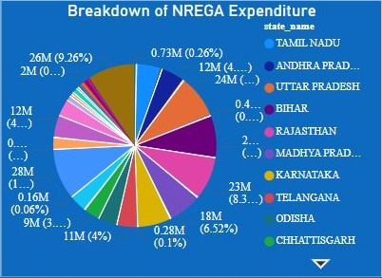
Expenditure Breakdown
Values: Total Expenditure (Rs. in Lakhs), Wages (Rs. in Lakhs), Material and Skilled Wages (Rs. in Lakhs), Total Administrative Expenditure (Rs. in Lakhs)
Insight: Visualize the distribution of expenditure categories, highlighting the allocation of funds.

Slide 10
Employment Distribution by Category
X-axis: State Name/District Name
Y-axis: SC Workers Against Active Workers, ST Workers Against Active Workers, Women Persondays, Differently Abled Persons Worked
Insight: Examine the distribution of employment opportunities among various categories of workers.

Slide 11
Job Cards and Active Workers Analysis
X-axis: State Name/District Name
Y-axis: Total No. of JobCards issued, Total No. of Active Workers
Insight: Compare the number of job cards issued with the number of active workers to assess the engagement level.

Slide 12
Work Completion Status
Values: Number of Ongoing Works, Number of Completed Works
Insight: Provide a clear view of the completion status of NREGA works, showing the proportion of ongoing vs. completed projects.

Slide 13
Conclusion and Recommendations
Summary of Insight:
Effective regions vs. underperforming regions.
Budget utilization efficiency.
Key factors driving work completion.
Recommendations:
Targeted interventions in underperforming regions.
Optimizing budget allocation.
Enhancing monitoring and reporting mechanisms.

Slide 14

Thank you
For joining on this journey of exploring NREGA Data Analysis and Insights.
Our knowledge and skills will continue to evolve with practice and experimentation.
FOLLOW ME
https://github.com/afahad7771
https://www.linkedin.com/in/ahmad-fahad-b2017822b/

